Slide 1
www.joindementiaresearch.nihr.ac.uk

Slide 2
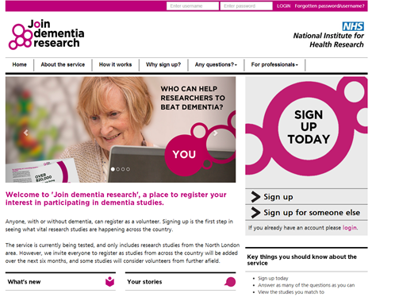
Join Dementia Research
A nationwide service that helps anyone in the UK find and take part in vital dementia research studies.
People with dementia, their carers, and anyone interested in research can sign up. It’s also possible to register on behalf of someone else.
www.joindementiaresearch.nihr.ac.uk
Notes:
Join Dementia Research Animation

Slide 3
Why is it needed?
It is only through research that we can develop effective treatments, improve care and one day find a cure.
So if you are looking for studies to take part in, but don't know where to find them, please visit:
www.joindementiaresearch.nihr.ac.uk

Slide 4
What kind of studies are there?
There are lots of different studies.
From looking at prevention and new treatments, to surveys aiming to improve the quality of life for people with dementia and their carers.
You do not have to take part in any particular studies.
It is always your choice whether or not to take part.
www.joindementiaresearch.nihr.ac.uk

Slide 5
How do I sign up?
You just need to provide some information about yourself which will enable the service to match you to suitable studies.
Online: www.joindementiaresearch.nihr.ac.uk
Over the phone: call our helplines
Alzheimer Scotland (0808 808 3000)
Alzheimer's Research UK (0300 111 5 111)
Alzheimer's Society (0300 222 1122)
By post: pick up a form at reception

Slide 6
Find us
www.joindementiaresearch.nihr.ac.uk
Facebook: /joindementiaresearch
Twitter: @beatdementia
Notes:
Twitter + fb icons

